Slide 1
API Tooling in the Eclipse
API Tooling in Eclipse | Chris Aniszczyk | © 2008 EclipseSource

Slide 2
Overview
The need for tooling
Tooling features
Tooling in action
Future work
Summary
Q&A
API Tooling in Eclipse | Chris Aniszczyk | © 2008 EclipseSource

Slide 3
The need for tooling
API Tooling in Eclipse | Chris Aniszczyk | © 2008 EclipseSource

Slide 4
Define API
APIs are published contracts
  Producers specify the contracts
    Honor contracts release after release
    Evolve the contracts for enhancements and fix problems
  Consumers adhere to the contracts
    Implement the contracts per specification
    Use provided implementations per contract specifications
API Tooling in Eclipse | Chris Aniszczyk | © 2008 EclipseSource

Slide 5
API Dimensions
API Use (Consumer)
X
X
Behavior remains constant over time as APIs evolve and grow.
API Evolution
(Producer)
API Tooling in Eclipse | Chris Aniszczyk | © 2008 EclipseSource

Slide 6
What have we done as plug-in developers?
We use Javadoc™ to document contracts
  This class is not intended to be instantiated or subclassed by clients.
  Has no effect if not read
  Inconsistent wording, placement, and use
Use component.xml to specify APIs
  Out of date, not maintained
  Why? Because there’s no tooling and it’s separate from the code
We use package names to categorize as public/internal, but all packages are exported
We use OSGi package exports to limit visibility, but does not prevent access to internal types
We use Eclipse’s “access rules” to discourage use, but this can be turned off
API Tooling in Eclipse | Chris Aniszczyk | © 2008 EclipseSource

Slide 7
More things we do…
Manually examine API changes or use some external tool before a release
  Changes between releases can be significant
  Validation is time consuming and error prone
  Lost development time (due to checking and bugs found)
API Tooling in Eclipse | Chris Aniszczyk | © 2008 EclipseSource

Slide 8
Disclaimer
API design is still your problem
  Designing quality APIs
  Ensuring consistent behavior
But there are things that tooling can with…
API Tooling in Eclipse | Chris Aniszczyk | © 2008 EclipseSource

Slide 9
API Tooling Features
API Tooling in Eclipse | Chris Aniszczyk | © 2008 EclipseSource

Slide 10
API Tooling to the Rescue!
Reports
  Illegal API use
  Binary incompatibility relative to a baseline
  Incorrect bundle version numbers
  Missing or malformed @since tags
  Leakage of non-APIs types inside APIs
Tightly integrated toolset in the Eclipse SDK
  Currently limited to Plug-in projects/OSGi bundles
  Runs as a builder (auto-build, incremental and full builds)
  Immediate feedback as you develop and use APIs
API Tooling in Eclipse | Chris Aniszczyk | © 2008 EclipseSource

Slide 11
Specifying API Contracts
Use Javadoc tags
  E.g. @noimplement, @noextend, @noreference, @noinstantiate
Benefits
  Contracts live with the code for producers and consumers
  Content assist helps developers
  Available for projects that are not using 1.5 annotations
  Restrictions appear in published Javadoc APIs in a standard way
  Tools can process tags
API Tooling in Eclipse | Chris Aniszczyk | © 2008 EclipseSource

Slide 12
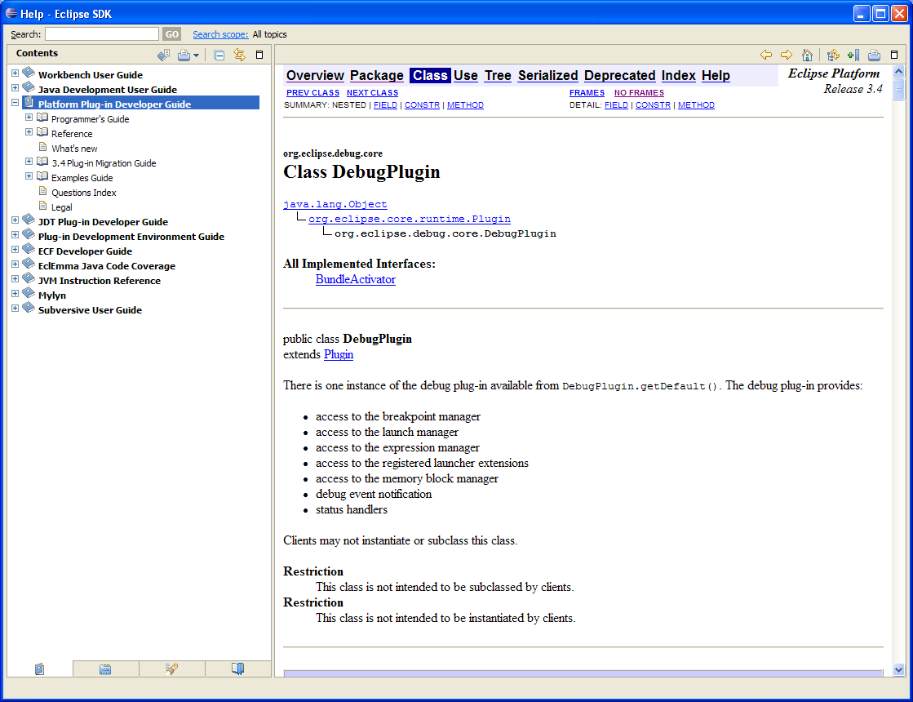
Example of Published API
API Tooling in Eclipse | Chris Aniszczyk | © 2008 EclipseSource

Slide 13
API Usage
Once the APIs are specified, the user needs to make sure that he/she is using them appropriately.
API usage is flagging any kind of illegal usage of API: reference to an API that is not supposed to be referenced, implementation of an interface that is not supposed to be implemented, ….
A consequence of wrong API usage is a potential binary incompatible change error.
API Tooling in Eclipse | Chris Aniszczyk | © 2008 EclipseSource

Slide 14
Validating Binary Compatibility
Evolving APIs such that they are backwards compatible with existing binaries
  http://wiki.eclipse.org/index.php/Evolving_Java-based_APIs
  It is easy to get it wrong
  Now the tooling takes care of this
The user simply specifies an API baseline
  Generally this means pointing to the previous release (N – 1)
API Tooling in Eclipse | Chris Aniszczyk | © 2008 EclipseSource

Slide 15
Bundle version number management
http://wiki.eclipse.org/index.php/Version_Numbering
The tooling takes care of letting the user know when the minor or major version of a bundle should be changed according to rules described in the document:
  A new API that is not a breaking change requires the minor version to be incremented
  A new API that is a breaking change requires the major version to be incremented
No support for the micro version for the initial release.
  Technically speaking, this version should be changed as soon as any modification is made in the source code: comment change, method body change,…
API Tooling in Eclipse | Chris Aniszczyk | © 2008 EclipseSource

Slide 16
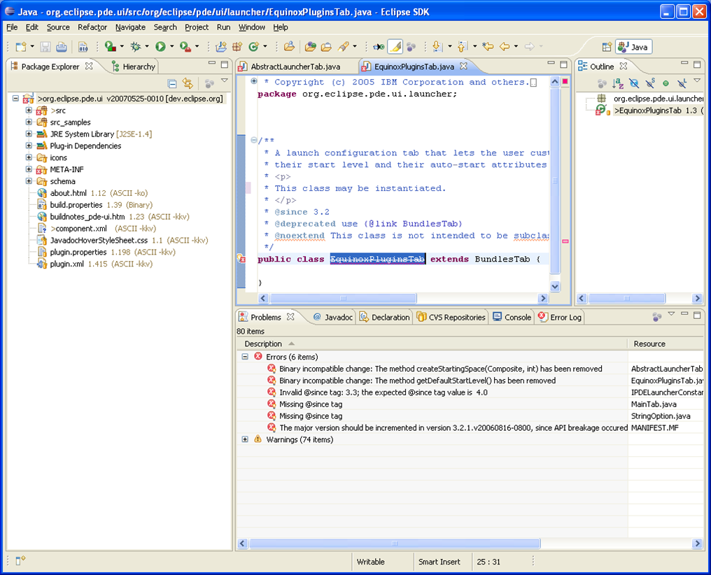
API Tooling in Action (simulation of bug 191231/191232)
API Tooling in Eclipse | Chris Aniszczyk | © 2008 EclipseSource

Slide 17
API Tooling Parts
API Tooling in Eclipse | Chris Aniszczyk | © 2008 EclipseSource

Slide 18
API Profile and API Components
These are the two major pieces used by the API tooling tools to make diagnosis on the code
An API profile can be seen like a PDE target platform.
An API profile is a collection of API components.
It is initialized using an Eclipse SDK installation plugins directory.
Inside the IDE, a profile corresponding to the workbench contents is automatically created.
API Tooling in Eclipse | Chris Aniszczyk | © 2008 EclipseSource

Slide 19
API Description
This contains the specific restrictions for all the API types of an API component
It is kept up-to-date inside the workbench by using resource listeners
It is exported inside the binary bundles or generated at build time using an ant task.
API Tooling in Eclipse | Chris Aniszczyk | © 2008 EclipseSource

Slide 20
Filtering of API Problems
Each component can define a problem filter
The filtering can be used to remove from reports known breakages.
For example, an API breakage has been approved by the PMC and you don’t want to get it reported for each build.
The problem filter is also part of the binary plug-in
API Tooling in Eclipse | Chris Aniszczyk | © 2008 EclipseSource

Slide 21
Two aspects: IDE and build process
Each feature is available from within the IDE or inside the build process.
The IDE support is required to help the Eclipse developer while the code is written
The build process support is required to provide feedback during the Eclipse build. This also allows other projects to use it inside their builds.
API Tooling in Eclipse | Chris Aniszczyk | © 2008 EclipseSource

Slide 22
Build support
Addition of new ant tasks:
  Generation of .api_description file
  Comparison of SDK drops: binary compatibility, api usage reports
Integration inside the Eclipse builds (headless mode)
Integration inside ant build (no Eclipse running)
API Tooling in Eclipse | Chris Aniszczyk | © 2008 EclipseSource

Slide 23
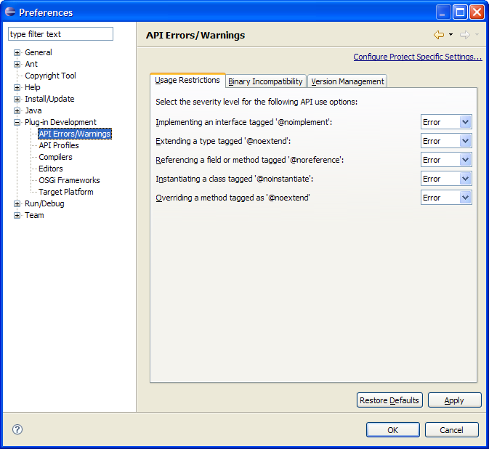
API Error/Warning Preferences
API Tooling in Eclipse | Chris Aniszczyk | © 2008 EclipseSource

Slide 24
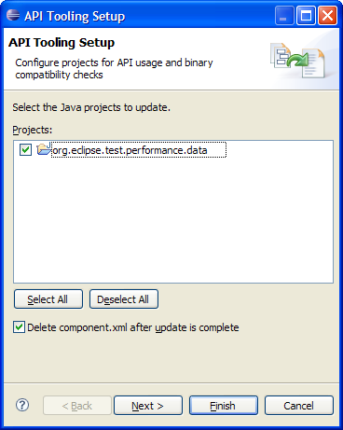
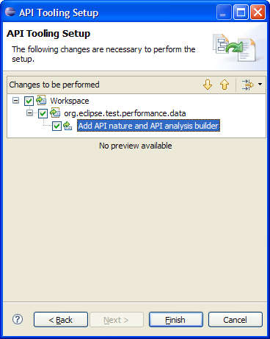
API Setup Wizard
API Tooling in Eclipse | Chris Aniszczyk | © 2008 EclipseSource

Slide 25
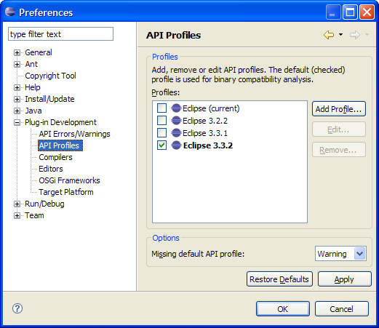
API Profile Preferences
API Tooling in Eclipse | Chris Aniszczyk | © 2008 EclipseSource

Slide 26
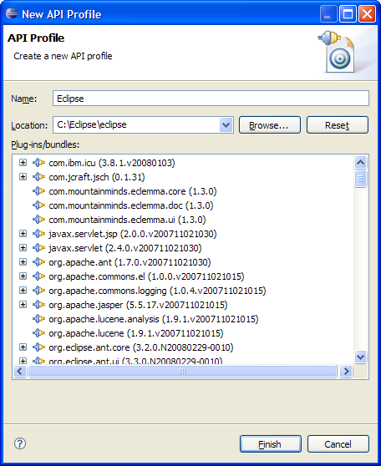
API Profile Wizard
API Tooling in Eclipse | Chris Aniszczyk | © 2008 EclipseSource

Slide 27
Future work
API Tooling in Eclipse | Chris Aniszczyk | © 2008 EclipseSource

Slide 28
To be done...
Handling of package versioning
Support extended to support more than just bundles
  Pure Java™ projects
  Plug-in extension points
Detect illegal use of system libraries with regards to the execution environment set for a project
  i.e. referencing J2SE™-1.5 code when set to J2SE-1.4
Improve integration with rel-eng build reporting
Determine compatible version range of required bundles
And what you might suggest...
API Tooling in Eclipse | Chris Aniszczyk | © 2008 EclipseSource

Slide 29
Summary
API Tooling in Eclipse | Chris Aniszczyk | © 2008 EclipseSource

Slide 30
API Tooling today
Help you to define your API restrictions
Keep a consistent and standard presentation of API restrictions
Detect binary breakage between a baseline and the current version
Detect wrong API usage
Detect wrong @since tags and inconsistent bundle versioning
API Tooling in Eclipse | Chris Aniszczyk | © 2008 EclipseSource

Slide 31
Links
Wiki
  http://wiki.eclipse.org/Api_Tooling
Bugzilla
  https://bugs.eclipse.org/bugs/enter_bug.cgi?product=PDE
API Tooling in Eclipse | Chris Aniszczyk | © 2008 EclipseSource

Slide 32

Q & A
API Tooling in Eclipse | Chris Aniszczyk | © 2008 EclipseSource

